Slide 1
Name:- Devanshi Sojitra
Kavya Bhuva
Jinal Kanani
Enrollment:- 92300527005
92300527006
92300527036
Topic Name:- Café management system
Subject :- SIP project 2

Slide 2

CAFÉ MANAGEMENT SYSTEM

Slide 3
TOPIC
Introduction
Objective
Functions
Features
Conclusion

Slide 4
INTRODUCTION
This pyhton program is functional graphical user interface (GUI) application for
a Cafe Management System, developed using the tkinter library. It presents a menu of items such as coffee, tea, pizza, and more, each associated with a fixed price. Users can select an item and quantity from dropdown menus and add them to an order. The system dynamically updates an order summary and includes functionality to calculate the total bill with added tax and service charges. Users can also clear the order and start afresh. It features user-friendly error messages and confirmation pop-ups to guide user interactions. The entire application is encapsulated within a class, showcasing the use of object-oriented programming principles. This system is ideal for small cafe setups to streamline order management in an interactive way.

Slide 5
OBJECTIVES
1. Efficient Order Management - Enable fast, accurate intake of customer orders.
2. Reliable Billing & Payment Processing - Automatically calculate totals including taxes and service charges.
3. Enhanced Customer Experience - Simplify UI for quick ordering and seamless checkout.
4. Insightful Reporting & Analytics - Generate sales reports, revenue trends, and top-selling items.

Slide 6
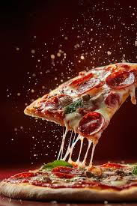
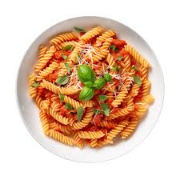
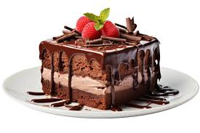

Slide 7
FUNCTIONS
1. add_to_order(self) -
Called when “Add to Order” is clicked:
Retrieves selected item and quantity
Validates their correctness
Adds them to self.order
Displays a success
2. update_order_summary(self) -
Refreshes the order summary box after any change:
Clears the text
Lists each ordered item with its quantity and total price
3. calculate_total(self) -
Triggered by the “Calculate Total” button:
Validates that the order is not empty
Computes subtotal, 5% tax, 10% service charge, and the grand total

Slide 8
FEATURE
Real-time Menu Display: Shows items with their prices dynamically.
Order Management: Add items and quantities to build an order.
Order Summary Panel: Lists current items, quantities, and line prices.
Automated Billing: Calculates subtotal, 5% tax, 10% service charge, and grand total.
Order Reset: Clears current order and updates the summary.

Slide 9


Slide 10
CONCLUSION
This Cafe Management System code is a simple yet effective desktop application built with Python's Tkinter library. It provides an intuitive user interface to manage cafe orders by allowing users to select items from a predefined menu, specify quantities, and calculate the total bill including tax and service charges. The use of features like a fullscreen window, background image, dropdown menus, and order summary display ensures a smooth and user-friendly experience. Although currently functioning as a basic POS system, the code lays a solid foundation for further enhancements such as database integration, inventory management, and multi-user support. Overall, this implementation demonstrates how Python can be used to develop practical and accessible cafe management tools, suitable for small businesses or learning projects in GUI application development.

Slide 11
Thank You....!

